Slide 1
Capstone Engagement
Assessment, Analysis, and Hardening of a Vulnerable System

Slide 2
Table of Contents
This document contains the following sections:
01
Network Topology
02
Red Team: Security Assessment
03
Blue Team: Log Analysis and Attack Characterization
Hardening: Proposed Alarms and Mitigation Strategies
04

Slide 3
Network Topology
3

Slide 4
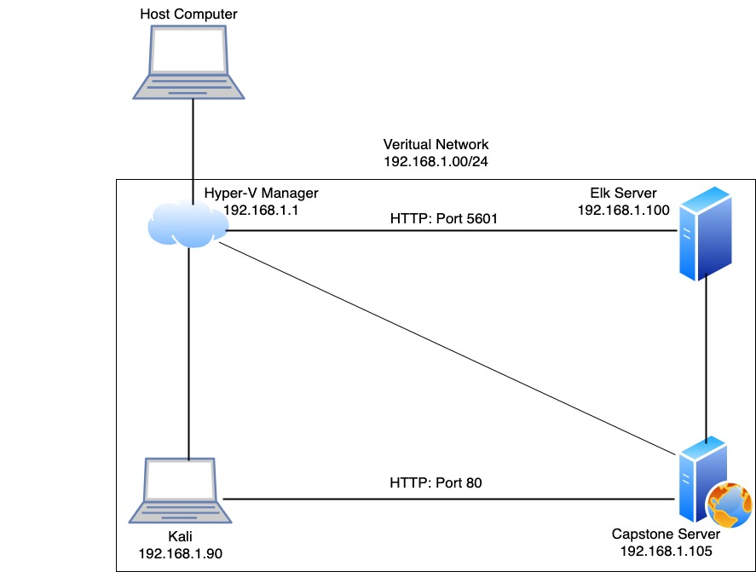
Network Topology
Network
Address Range: 192.168.1.0/24
Netmask: 255.255.255.0
Gateway: 192.168.1.1
Machines
IPv4: 192.168.1.1
OS: Windows
Hostname: Hyper-V Manager
IPv4: 192.168.1.90
OS:Kali Linux
Hostname: Kali
IPv4: 192.168.1.105
OS: Linux
Hostname: Server 1
IPv4: 192.168.1.100
OS: Linux
Hostname: Elk

Slide 5

Red Team
Security Assessment
5

Slide 6
Recon: Describing the Target
Nmap identified the following hosts on the network:
Hostname | IP Address | Role on Network
Hyper-V Manager ML- REFVM 684427 | 192.168.1.1 | VM, Host Machine
Kali | 192.168.1.90 | Attack Machine
Elk Server | 192.168.1.100 | Network Monitoring Kibana
Capstone Server Server 1 | 192.168.1.105 | Target Machine

Slide 7
Vulnerability Assessment
The assessment uncovered the following critical vulnerabilities in the target:
Vulnerability | Description | Impact
Path Traversal/Local File Inclusion | External input to construct a pathname that should be within a restricted directory, but it does not properly neutralize sequences, that can resolve to a location that is outside of that directory. | Attacker can traverse the files/directories to locate sensitive files.
Unauthorized File Upload | Allows for an upload or transfer of a file which can be processed/executed in server | PHP file was uploaded onto the server
Simple Hashed Password | Simple hashed passwords can easily be cracked using wordlists and dictionary attacks | User passwords were easily cracked using crackstation.net

Slide 8
Vulnerability Assessment
The assessment uncovered the following critical vulnerabilities in the target:
Vulnerability | Description | Impact
WebDAV | Improper handling of commands in memory, allowing code to be entered/run on target system. | Attacker can use WebDAV to access and modify website.
Password-Brute Force | Attacker uses lists of usernames and passwords to test and then access a system. | An attacker is able to use brute force to locate and crack a user password in the system
Remote Code Execution | Allows for an attacker to remotely execute malicious code on a computer. | Allowed full access to the target machine

Slide 9
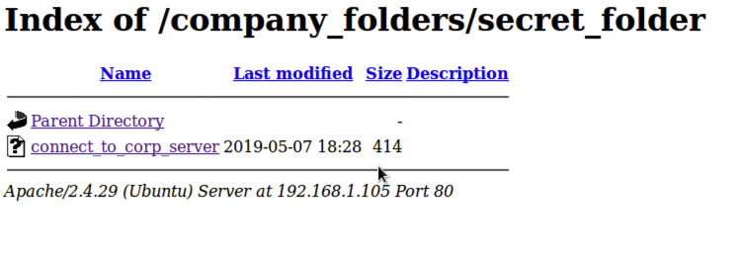
Exploitation: Path Traversal
Achievements
Provided user name, knowledge and access to secret_folder and connect_to_corp_server file.
01
02
Tools & Processes
Directory traversal on the Target’s webpage.
03

Slide 10
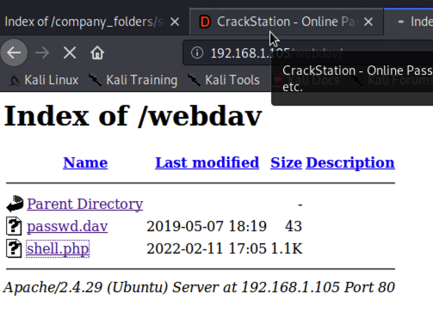
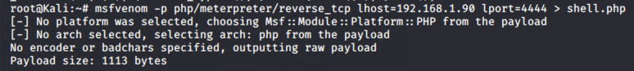
Exploitation: Unauthorized File Upload
01
02
Tools & Processes
Using msfvenom and meterpreter a file was uploaded to the server
Achievements
Shell.php was uploaded onto the server exploiting the WebDAV vulnerability
03

Slide 11
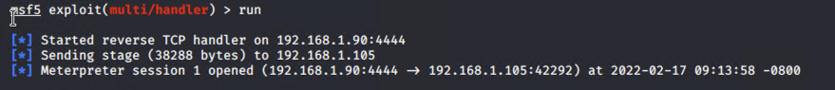
Exploitation: Remote Code Execution
01
02
Tools & Processes
Using Metasploit a remote command using a reverse TCP was used to execute the uploaded file and create a Meterpreter session.
Achievements
Shell.php was executed giving full access to the server.
03

Slide 12
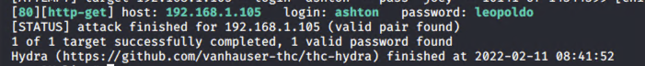
Exploitation: Brute Force Password
01
02
Tools & Processes
Hyda was used to to brute force Ashton’s password
Achievements
The password provided access to a secret folder, which then granted access to upload a php file.
03

Slide 13
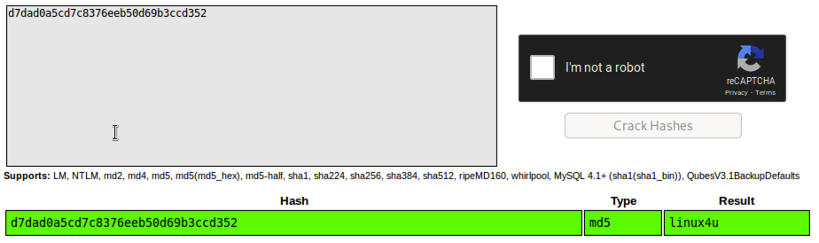
Exploitation: Simple Hashed Password
02
01
Achievements
This provided access to the connect_to_corp_server file, which provided info and access to the WebDAV vulnerability.
Tools & Processes
Using crackstation.net a password was cracked
03

Slide 14

Blue Team
Log Analysis and Attack Characterization
14

Slide 15

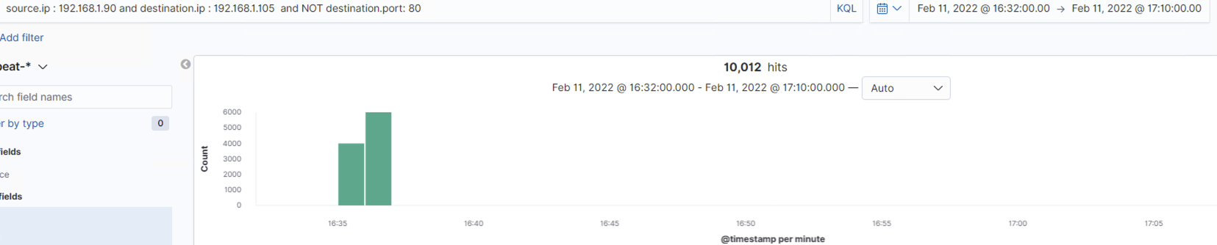
Analysis: Identifying the Port Scan
The port scan began around 1635 hours.
10,012 hits were sent from 192.168.1.90.
There were just over 10,000 scans sent to different ports.

Slide 16
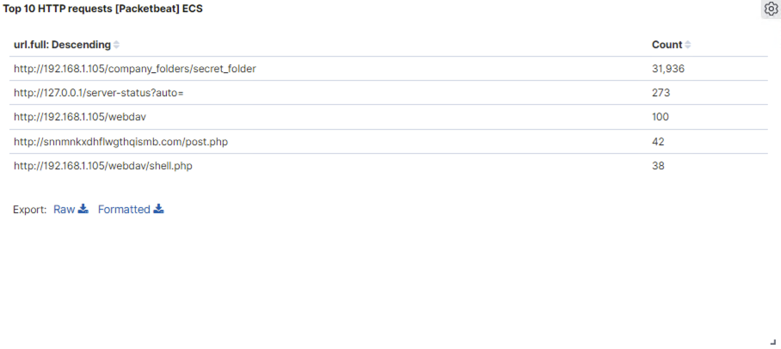
Analysis: Finding the Request for the Hidden Directory
Requests for the hidden directory occurred bwtween 1637 and 1708 hours. There were a total of 31,936 request made.
The hidden folder contained user login info and instructions on how to access WebDAV server.

Slide 17
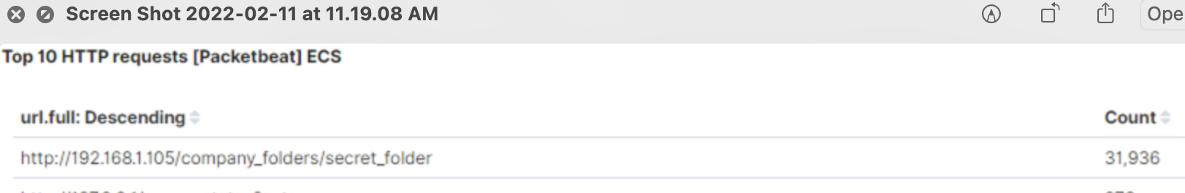
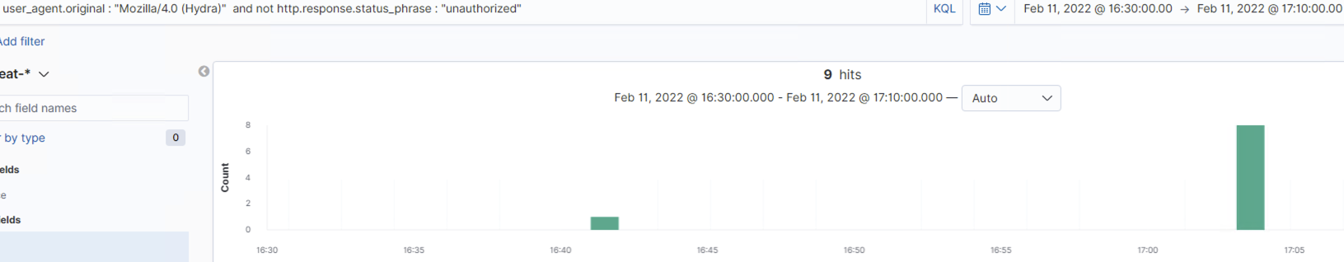
Analysis: Uncovering the Brute Force Attack
31,936 requests were made during the attack.
Out of the 31,936 requests, 9 were successful.

Slide 18
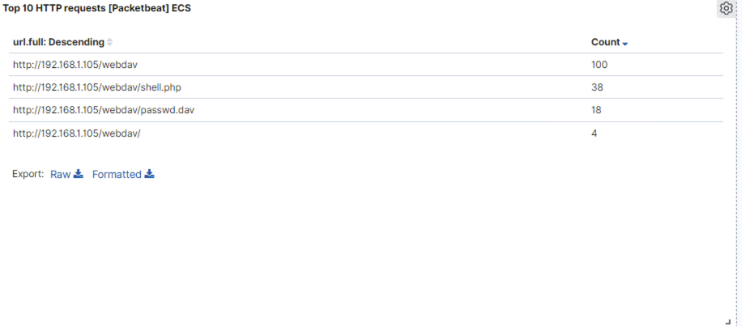
Analysis: Finding the WebDAV Connection
There were 104 request made to the WebDAV directory
The password.dav and shell.php were the files requested.

Slide 19
Blue Team
Proposed Alarms and Mitigation Strategies
19

Slide 20
Mitigation: Blocking the Port Scan
An alarm can be set to detect the number of port scans committed within a set time frame and the number of scans performed by a single IP address.
The threshold with be set at 10 ports scan in under 5000 microseconds and/or more than 100 consecutive requests from a single IP address.
Keep firewalls up to date
Use IDS to detect and alert when thresholds met.
Use IPS to block the traffic once thresholds met
A firewall enabled with the right tools can mitigate port scans.

Slide 21
Mitigation: Finding the Request for the Hidden Directory
Notification for attempted access from an IP address outside the network.
Notification if the IP address attempting to access the directory or file is not on the whitelist.
The threshold would be set at 1.
Create a whitelist for the directory and file
Move the directory and file so they are not accessible on the webserver.
rmdir –r ./sercret_folder
Move directory to another server not accessible on the webserver

Slide 22
Mitigation: Preventing Brute Force Attacks
Set an alert for status code 401 “Unauthozied” at a certain threshold
Set an alert for login attempts from a single IP address to multiple accounts
Set an alert for multiple logins to a single account from multiple IP address.
More than 10 ‘401’ codes from single IP address
More than 3 different login attempts from same IP address
More than 2 logins from different IP address
Use a CAPTCHA to prevent automated attacks
Require answers to security questions after 3 failed logins.
Use device cookies as additional authenticator.
Use Multifactor authentication
Requiring additional steps or authentication can slowdown, deter or prevent attacks.

Slide 23
Mitigation: Detecting the WebDAV Connection
Set whitelist for only IP address from inside the company
Set an alert for IP address’ not on the whitelist.
Combine WebDAV with two-factor authentication
Enforce whitelist and blacklist policies
Access by strict user names and passwords

Slide 24
Mitigation: Identifying Reverse Shell Uploads
Set an alert for traffic utilizing port 4444
Set an alert for .php files uploaded to being uploaded to the server
Any traffic would trigger the alert
Prevent the files from being uploaded to the server via the website.

